Slide 1

academic life by academic life

Slide 2
Team project
Simple one player game focusing on player’s ability to do quick calculations
Math lovers and mega minds are our target audience
Where can it be found: link here
Notes:
You should have a working knowledge
of basic object-oriented programming concepts and at least some experience
programming in C++.

Slide 3
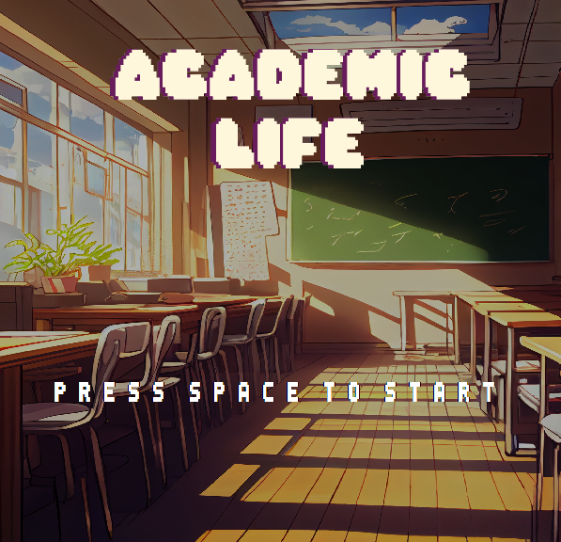
screenshots
Ready?
Notes:
The two players are getting ready for the race.

Slide 4
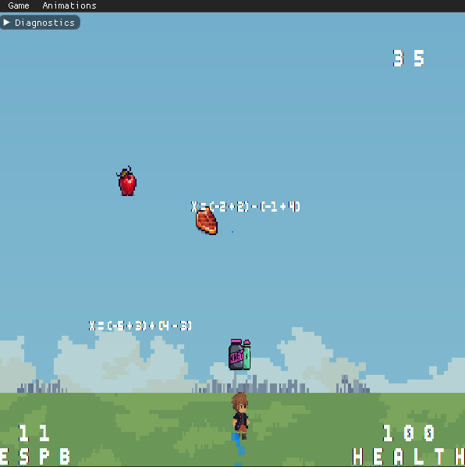
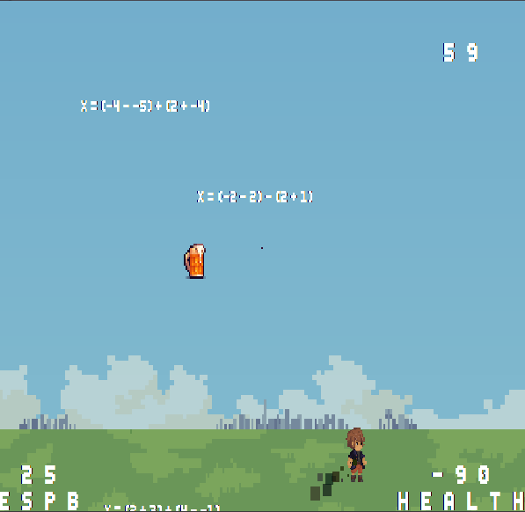
screenshots
Notes:
Player 2 missed the jump and is falling on the spikes.

Slide 5
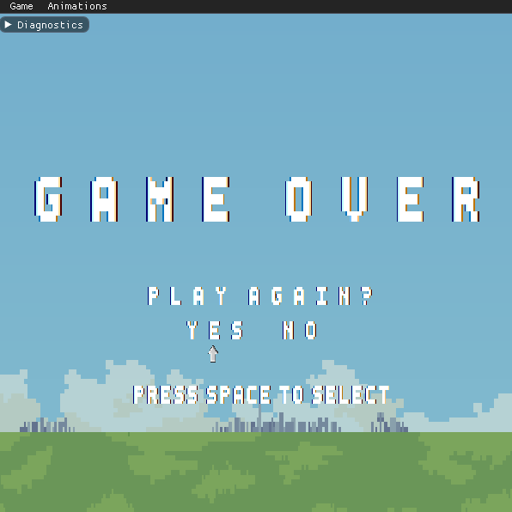
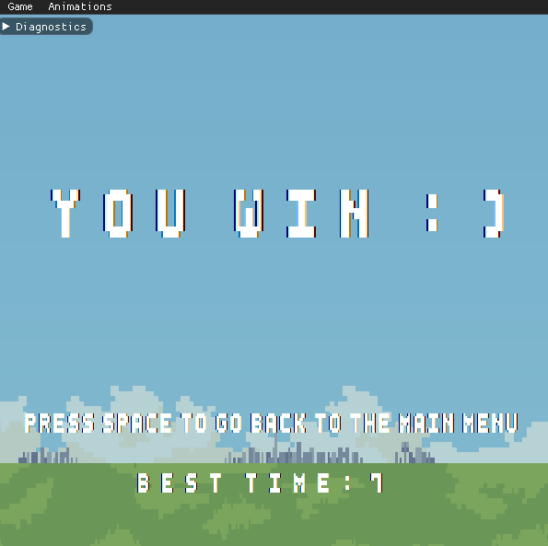
screenshots
Notes:
Game ends, player 1 wins.

Slide 6
Team members
Anđelija Vasiljević
Stefan Jevtić
Vukašin Marković
Marko Nikitović
Anja Cvetković
Notes:
You should have a working knowledge
of basic object-oriented programming concepts and at least some experience
programming in C++.

Slide 7
Game description
In order to finish the game our player needs 240 ECTS/ESPB points
How to get there you may ask? By collecting equations falling from the sky, of course!
Notes:
You should have a working knowledge
of basic object-oriented programming concepts and at least some experience
programming in C++.

Slide 8
Game description
Along equations, the player will encounter lifestyle items
They impact player’s health and movement speed positively or negatively
But here’s a catch: greater ECTS/ESPB score means that items will fall faster and equations will become harder
So make sure not to get caught up in drinking too much beer...
Notes:
You should have a working knowledge
of basic object-oriented programming concepts and at least some experience
programming in C++.

Slide 9
Game features
Controls: Players can move by using A and D keys
Gameplay mechanics: item/player collisions, score and health updating
End mechanics: win conditions: collect 240 ects/espb points, lose conditions: health goes below -100 or ects/espb points fall to zero
Notes:
You should have a working knowledge
of basic object-oriented programming concepts and at least some experience
programming in C++.

Slide 10
Game features
Falling items: equation and lifestyle items generator
Different difficulty levels of equations
Different speed levels of falling items and player
Notes:
You should have a working knowledge
of basic object-oriented programming concepts and at least some experience
programming in C++.

Slide 11
Game features
End mechanics: win conditions: collect 240 ects/espb points, lose conditions: health goes below -100 or ects/espb points fall to zero
Notes:
You should have a working knowledge
of basic object-oriented programming concepts and at least some experience
programming in C++.

Slide 12
Game features
ui
sprite design
character animations
particle effect
Notes:
You should have a working knowledge
of basic object-oriented programming concepts and at least some experience
programming in C++.

Slide 13
Postmortem
What went well?
team work
infinite possibilities for improvement and new features
easy task management
Notes:
You should have a working knowledge
of basic object-oriented programming concepts and at least some experience
programming in C++.

Slide 14
Postmortem
Features not implemented:
mute button
avatar choice
advanced equations
leader-board
advanced interaction between graphic elements and code logic
Notes:
You should have a working knowledge
of basic object-oriented programming concepts and at least some experience
programming in C++.

Slide 15
Postmortem
What went wrong?
lack of time for improvement and new features
clean code maintenance
external library for equations
Notes:
You should have a working knowledge
of basic object-oriented programming concepts and at least some experience
programming in C++.

Slide 16
Postmortem
If we could start over, we would:
have a clearer image and focus on development of clean and efficient code
Notes:
You should have a working knowledge
of basic object-oriented programming concepts and at least some experience
programming in C++.

Slide 17
Postmortem
Some of the great additions to dagger would be:
buttons
conan package manager for external libraries
Notes:
You should have a working knowledge
of basic object-oriented programming concepts and at least some experience
programming in C++.

Slide 18
Postmortem
What have we learned?
team work beats every engine problem
Notes:
You should have a working knowledge
of basic object-oriented programming concepts and at least some experience
programming in C++.

Slide 19
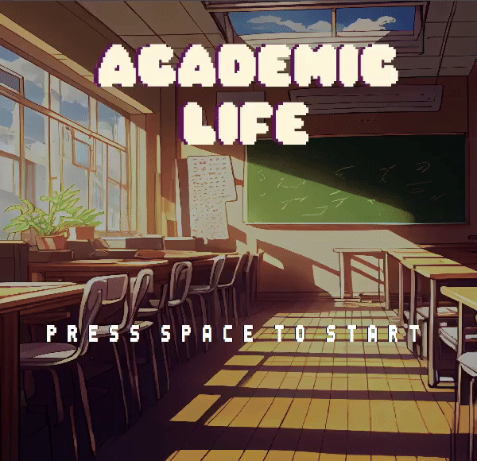
DEMO
Notes:
The players begin racing, player 2 (Bald pirate) takes the safer route, while player 1 (Bomb guy) takes the speed power-up, and makes a difficult jump.

Slide 20
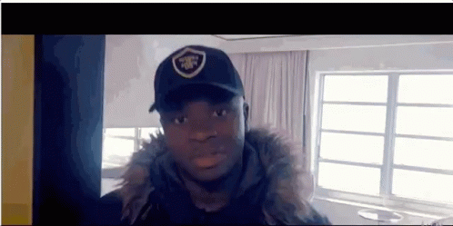
We want to share...
Notes:
You should have a working knowledge
of basic object-oriented programming concepts and at least some experience
programming in C++.

Slide 21
Thank you!
Notes:
You should have a working knowledge
of basic object-oriented programming concepts and at least some experience
programming in C++.

Slide 22
Questions
Notes:
You should have a working knowledge
of basic object-oriented programming concepts and at least some experience
programming in C++.

